Slide 1
Explore the cosmos
Nova DB
Hipparcos ID:
Spectral Type:
Constellation:
Distance: Between
And
pcs
Coordinates:
RA:
±
Dec:
±
Magnitude:
±
PRESENTED BY MARTIN GARCIA, ADAM SCHEERER, & ANDREW WILKINS
Notes:
Dark Starfield - https://giphy.com/gifs/gif-artist-glas-2017-ericaofanderson-l3q2RgN7WUjeUUXm0
Purple Starfield - https://giphy.com/gifs/trippy-weird-psychedelic-3ov9k1173PdfJWRsoE

Slide 2
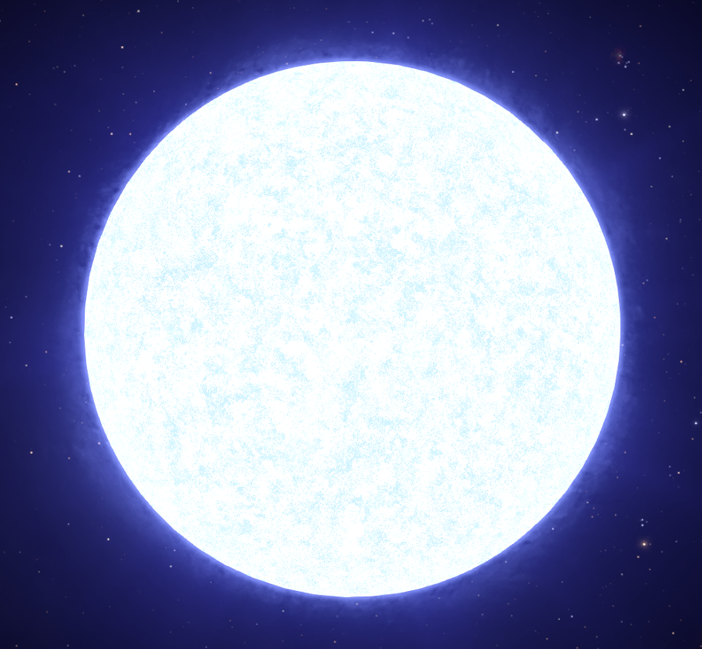
Hipparcos ID:
STAR NAME
Constellation:
Spectral Type
Coordinates:
RA:
Dec:
Distance:
Magnitude:
Abs. Mag:
Luminosity:
Variable Magnitude:
Min:
Max:
Star System Name:
Companion ID:

